Slide 1

The Future of Medicine: Exploring Embedded Computers in Simulations and Robotics in the Surgical Field
Andrew Kalathra
B.S in Computer Science, Pre-Medical Focus
Lamar University, May 2025

Slide 2
Graphic Image Warning! ********
As this is a comparison to surgery, a few comparisons are used
Warning if uncomfortable with (slightly) graphic images

Slide 3
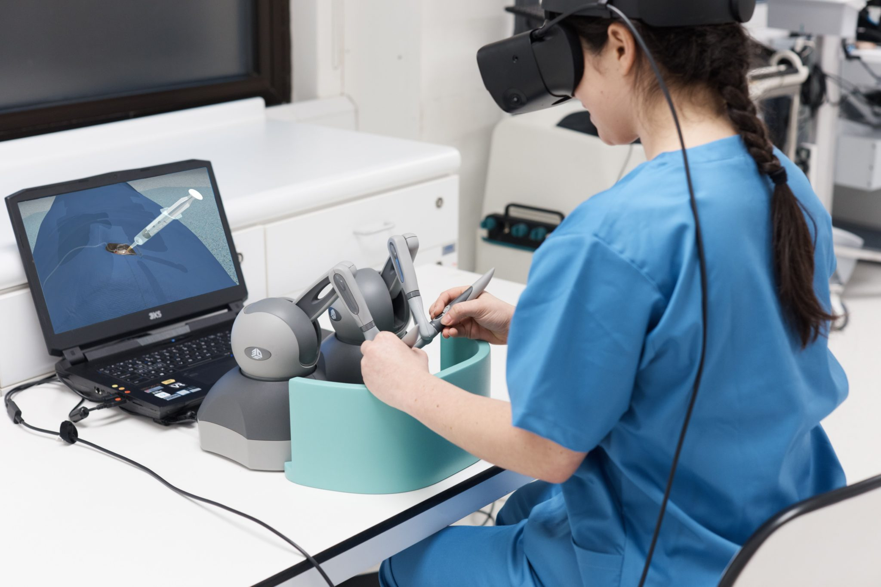
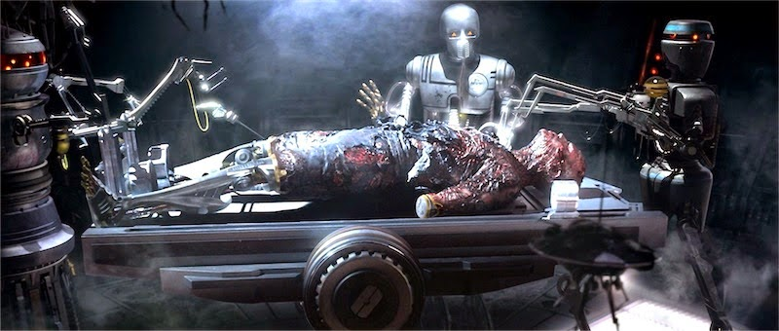
Introduction
Embedded computers in surgery
Virtual Surgery
Robotics in Surgery
Seen in Sci-fi…
Image courtesy Auganix
…but could this be a reality one day? If so, how soon?
Image courtesy Disney Star Wars

Slide 4
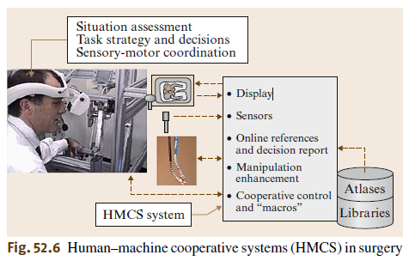
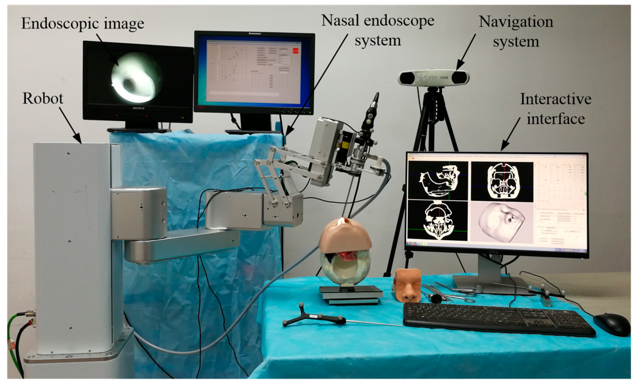
Robotics
Medical Robotics and Computer-Integrated Surgery
Taylor, Russel H, et al.
Discussed the general overview of medical robots and developing surgical technologies
Image courtesy MDPI
Image courtesy [5]

Slide 5
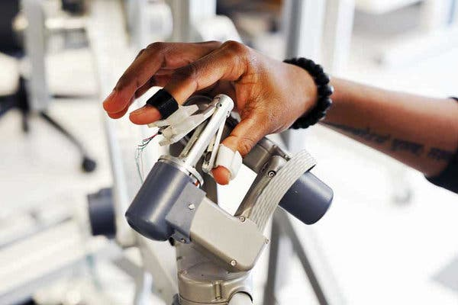
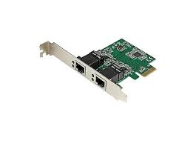
Robotics
There are many types of robots used in surgeries
Broadly, the modern robotic systems are meant to assist and to be controlled by the surgeon
The current popular mode of control is Hands on Compliant control, through Teleoperated control is growing
This implies there a variety of necessary computer architectural components, such as
NIC
motion controller
Processor capable of render 3D imaging
Integrated drivers for each instrument
Image courtesy Amazon
Image courtesy New York Times

Slide 6
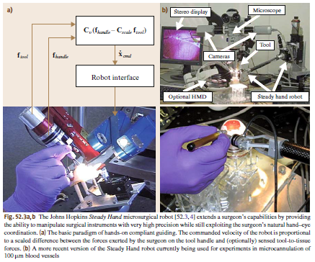
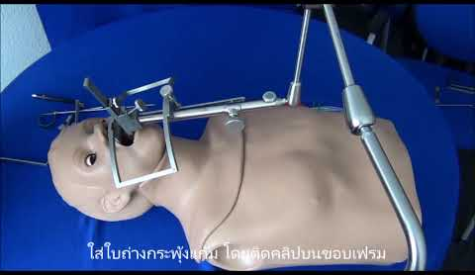
Robotics
The advances in this field has led to a variety of research topics, including the likes of
Telerobotic systems
Haptic Feedback Systems
Microsurgery systems
Endothelium Robots
Surgical Simulators
Image courtesy LARS, Sales Prosearch Supply
Image courtesy [5]

Slide 7
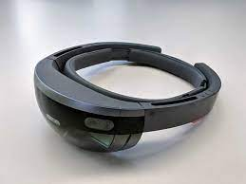
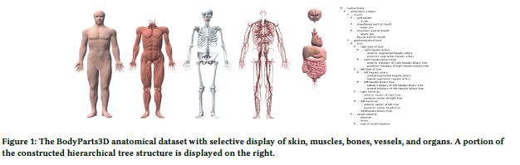
VR Simulations
Augmented Reality Anatomy Visualization for Surgery Assistance with HoloLens
By Coca, Antonio, et al.
Discussed the development of their augmented reality anatomy visualization tool
Applied using HoloLens
Image courtesy Microsoft
Image courtesy [1]

Slide 8

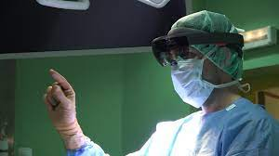
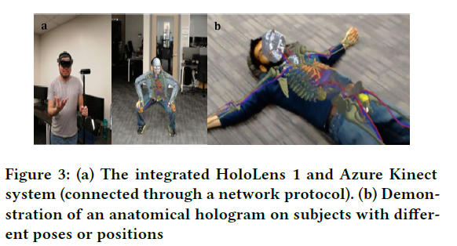
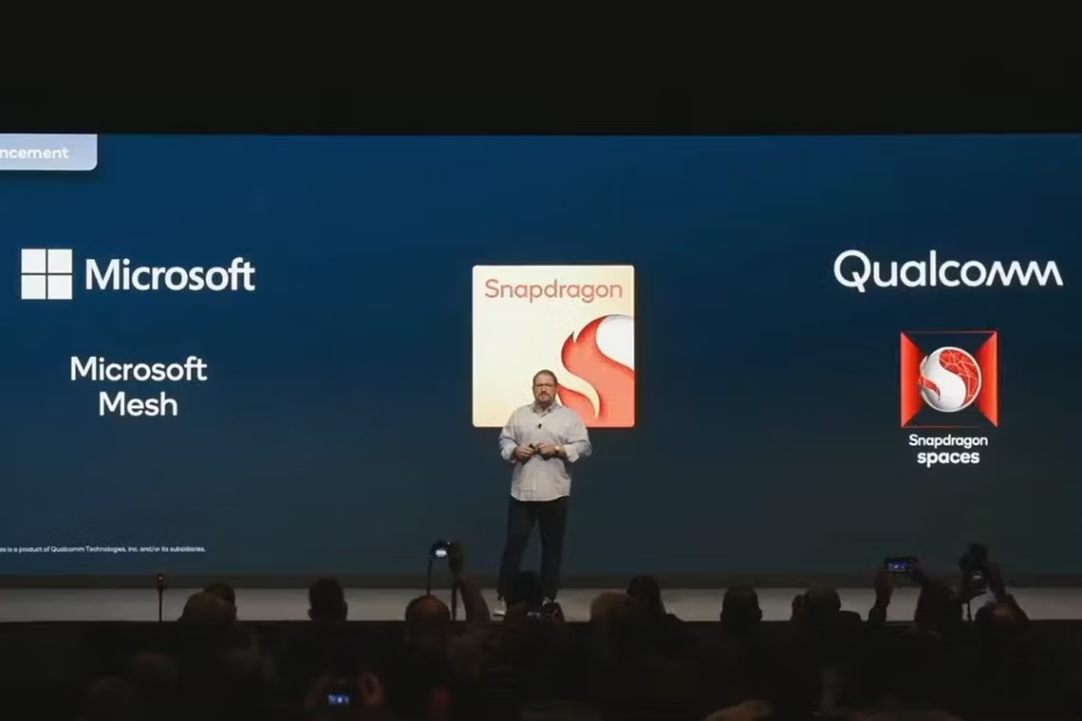
VR Simulations
HoloLens Architecture (and specs)
Uses Qualcomm Snapdragon 850 chip with integrated graphics
CPU & GPU ~ 2.96 GHz
Image courtesy Microsoft
Image courtesy Qualcomm
Image courtesy [1]
Image courtesy Microsoft

Slide 9
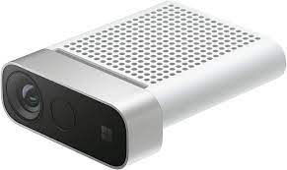
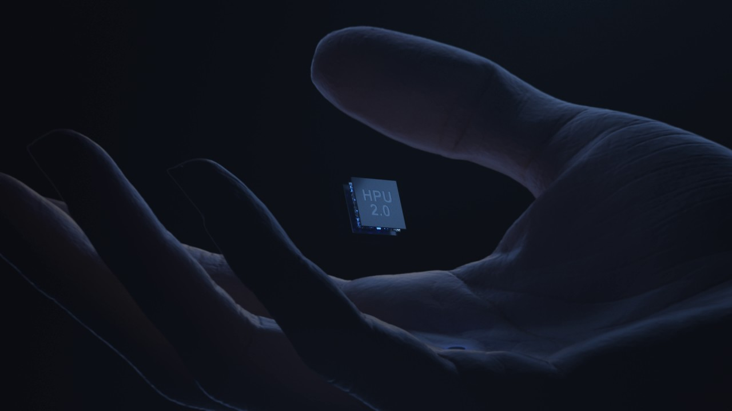
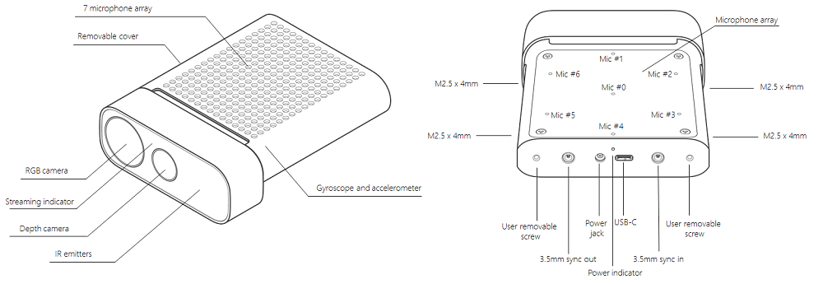
VR Simulations
Limited memory capacity, so Microsoft also supports their HPU chip to work alongside
HPU specializes in higher performance 3D rendering
Also includes Azure Kinect sensor (AI included)
Image courtesy Microsoft
Image courtesy Microsoft
Image courtesy Microsoft

Slide 10
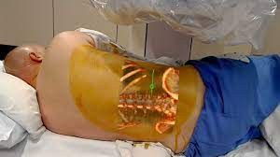
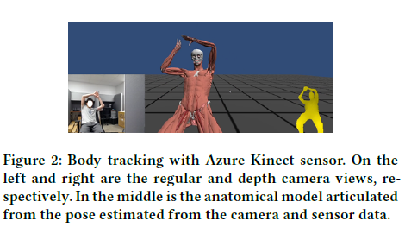
VR Simulations
Will continue to explore this technology as hardware and software advances
In future, will not need Azure Kinect sensor (even for HoloLens 2)
Image courtesy MobiHealth News
Image courtesy [1]

Slide 11
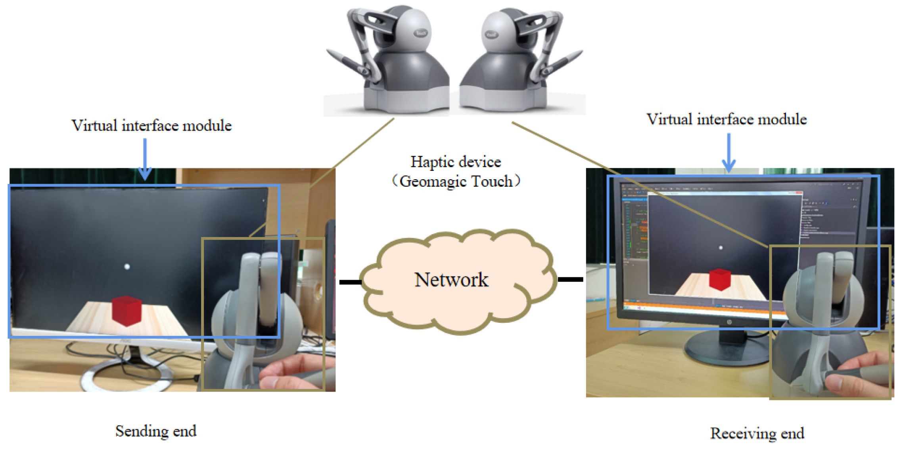
VR Simulations + Haptic Feedback
Building 3D Models for Reconstructing a Virtual Cataract Surgery Haptic Simulation
By Coca, Antonio, et al.
Discussed the application of haptic simulation in the virtual surgical environment
Used cataract surgery as proof of concept
Image courtesy MDPI

Slide 12
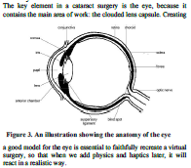
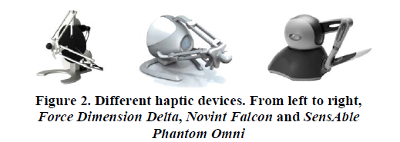
VR Simulations + Haptic Feedback
Not new technology, but definitely a field that (I believe) should be developed more
Purpose for this study was mainly catered to learning procedures prior to entering the operating room
Image courtesy [2]
Image courtesy [2]

Slide 13
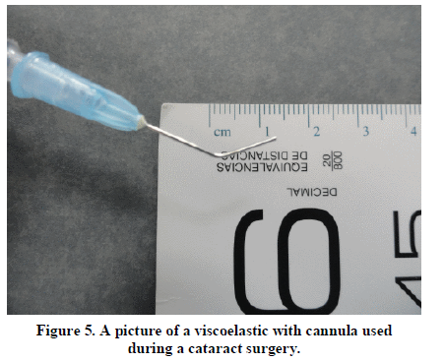
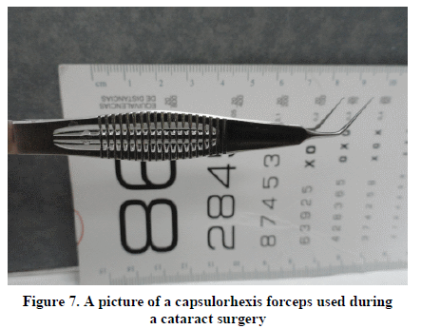
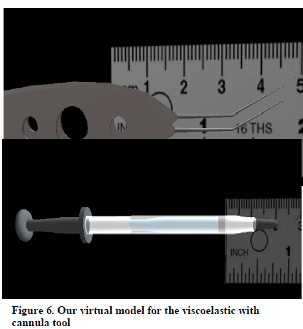
VR Simulations + Haptic Feedback
Mainly developed alongside virtual reality
As it is developed based on reality, factors such as tools must look and feel the same
Image courtesy [2]
Image courtesy [2]
Image courtesy [2]
Image courtesy [2]

Slide 14
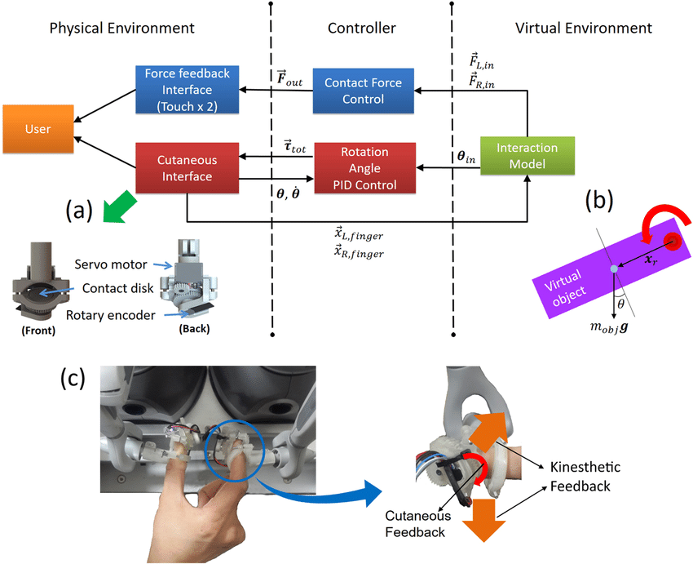
VR Simulations + Haptic Feedback
As seen in the image, many embedded computers are integrated in this type of technology
Along with the chips used for the simulation, the haptic device must also contain systems and drivers to correctly input and output the correct textures and forces
Image courtesy ResearchGate

Slide 15
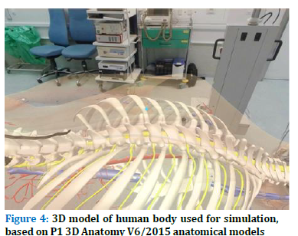
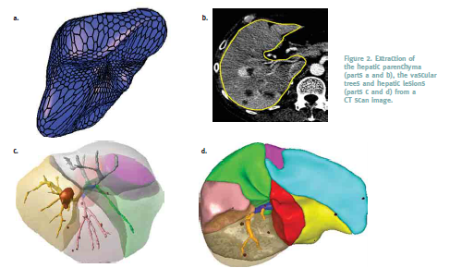
Application of VR Simulation
Virtual Simulation for Scoliosis Surgery
By Izard, Santiago Gonzalez, et al.
Discussed the application of a virtual surgery
Applied virtual surgical concepts to an entire 3D virtual surgical environment, complete with a 3D model in user intractability
Image courtesy [3]
Image courtesy Interstices

Slide 16
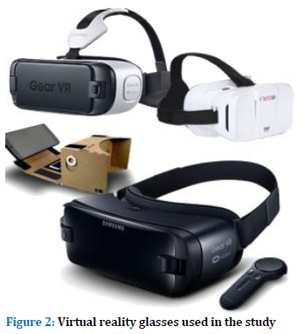
Application of VR Simulation
Main components of this process varied between using computers or phones, as well as a variety of different headsets
Oculus, Google Cardboard, and Samsung VR
Best outcome and usage was just a Samsung phone alongside Samsung VR
Supported Snapdragon 820 chips, which executed 3D environments seamlessly, and was much less expensive than Oculus
Image courtesy [3]

Slide 17
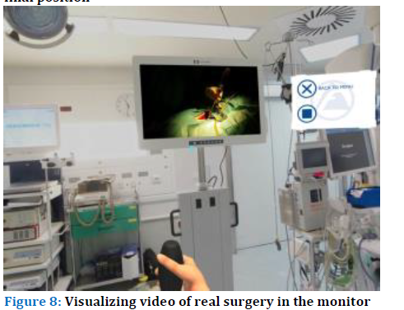
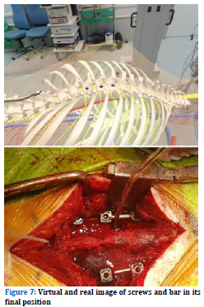
Application of VR Simulation
Software used included Unity for the general 3D development
Different software development kits were needed for the different hardware used
There were two main systems developed, one focused on the development for Google Cardboard, and the other focused on the development for the Oculus and Samsung VR
Image courtesy [3]
Image courtesy [3]
Image courtesy [3]

Slide 18
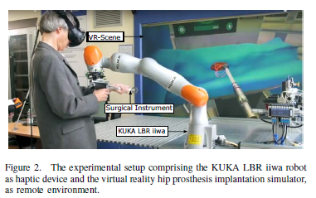
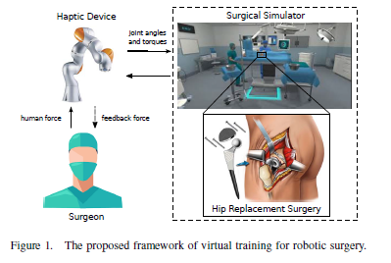
Current VR simulation with Haptic Feedback
Using the KUKA LBR iiwa Robot as Haptic Device for Virtual Reality Training of Hip Replacement Surgery
By Panariello, Dario, et al.
Discussed the application of the KUKA robot system for hip surgery
Image courtesy [4]
Image courtesy [4]

Slide 19
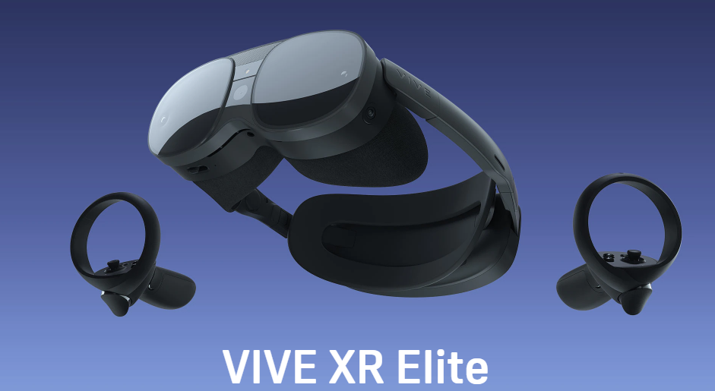
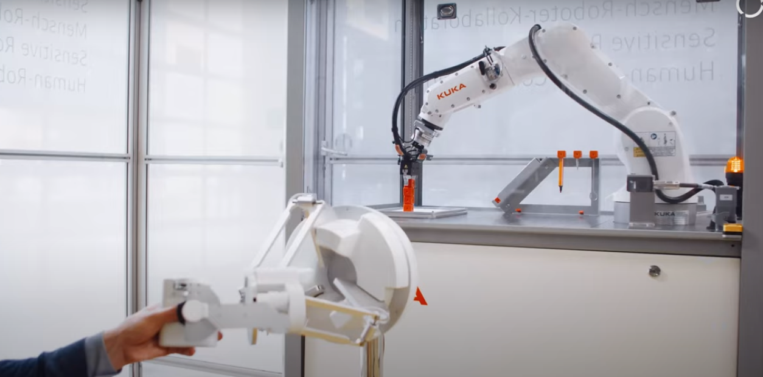
Current VR simulation with Haptic Feedback
Main architecture of the robotics of these professional system are unknown as they are developed by highly privatized company (aside that the operating system is Windows based)
Can deduce that there are specific drivers and embedded computers accustomed to each of the devices used, which include
the VIVE headset used, which is compatible with PC
An NIC, to reach network
Specific drivers for the haptic device
Image courtesy VIVE
Image courtesy KUKA

Slide 20
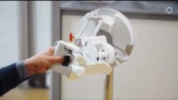
Current VR simulation with Haptic Feedback
https://youtu.be/ws9-w08GJaA

Slide 21
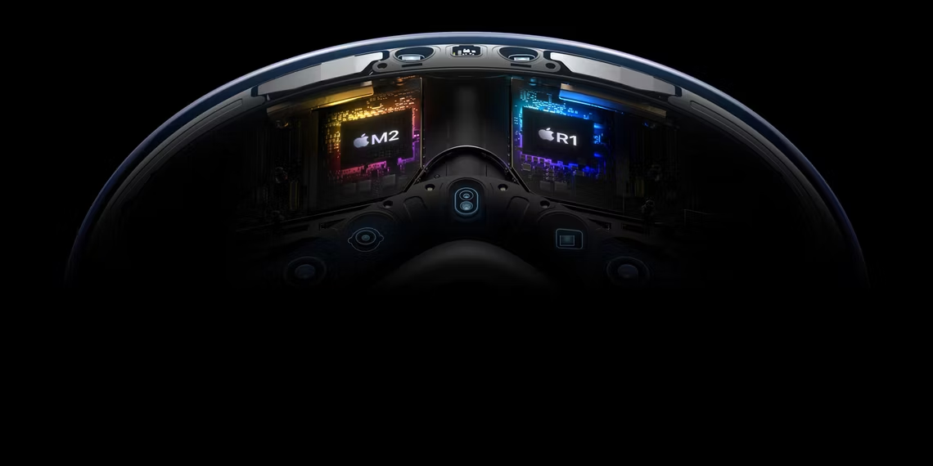
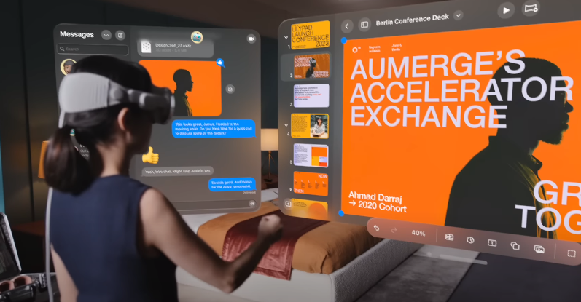
Conclusion
The surgical field has grown rapidly, and thanks to the technologies currently being developed, it seems like it will continue to grow.
These technologies are still being researched, but I believe that this field could greatly expand with custom or specifically built components. This would enhance and make these systems much more efficient, especially in the environments with other technologies used in the surgical field.
An example of this would be the Apple Vision Pro
Using both the M2 and R1 chip, the headset can process an immersive field with ease and work seamlessly with other Apple products, which enhances the experience
Image courtesy Apple
Image courtesy Apple

Slide 22
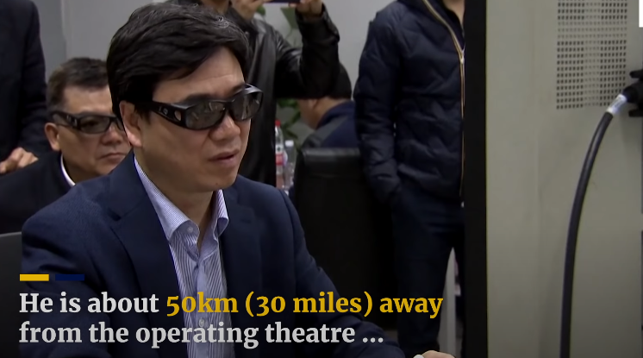
Conclusion
The application of these types of technologies are obscure, but the efficiency and the cost effectiveness of these systems make these systems a well researched topic
A few common applications (scenarios) where robotic and VR surgeries could be applied would be hostile environments where surgeons are needed
This would include in space, warzones, or disaster zones
https://youtu.be/yFR61jjL1vo
There are many applications for this technology, if the reader is interested, they are recommended to read the resources and additional resources
Image courtesy South China Morning Post

Slide 23
Resources
Castelan, Enrique, et al. “Augmented reality anatomy visualization for surgery assistance with HoloLens.” ACM International Conference on Interactive Media Experiences, 21 June 2021, https://doi.org/10.1145/3452918.3468005.
Coca, Antonio, et al. “Building 3D models for reconstructing a virtual cataract surgery haptic simulation.” Proceedings of the First International Conference on Technological Ecosystem for Enhancing Multiculturality, 14 Nov. 2013, https://doi.org/10.1145/2536536.2536544.
Izard, Santiago González, et al. “Virtual simulation for scoliosis surgery.” Proceedings of the 5th International Conference on Technological Ecosystems for Enhancing Multiculturality, 18 Oct. 2017, https://doi.org/10.1145/3144826.3145404.
Panariello, Dario, et al. “Using the KUKA LBR iiwa robot as haptic device for virtual reality training of hip replacement surgery.” 2019 Third IEEE International Conference on Robotic Computing (IRC), 2019, https://doi.org/10.1109/irc.2019.00094.
Taylor, Russell H., et al. “Medical Robotics and computer-integrated surgery.” Springer Handbook of Robotics, Jan. 2008, pp. 1199–1222, https://doi.org/10.1007/978-3-540-30301-5_53.

Slide 24
Extended Resources
Cypko, Mario A., et al. “Towards human-robotic collaboration: Observing teamwork of experienced surgeons in robotic-assisted surgery.” Mensch Und Computer 2022, 4 Sept. 2022, https://doi.org/10.1145/3543758.3549891.
Delingette, Herve, and Nicholas Ayache. “Hepatic surgery simulation.” Communications of the ACM, vol. 48, no. 2, Feb. 2005, pp. 31–36, https://doi.org/10.1145/1042091.1042116.

